Slide 1
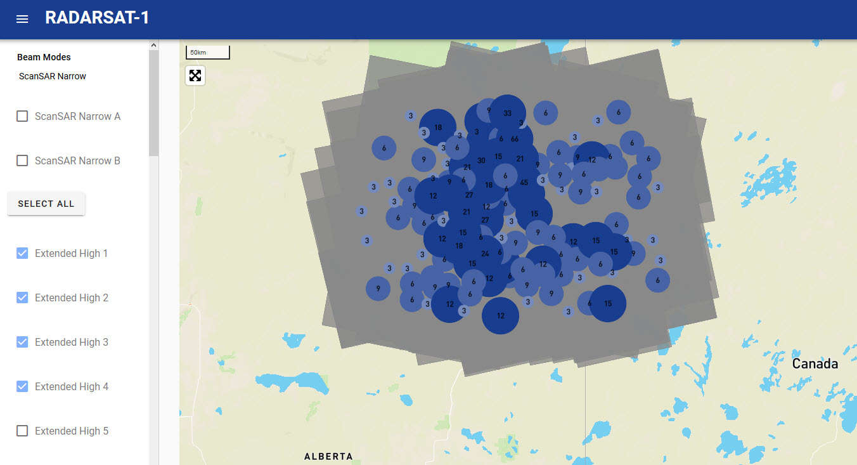
CSA Challenge #5
THE RADARSAT
LIBERATORS

Slide 2


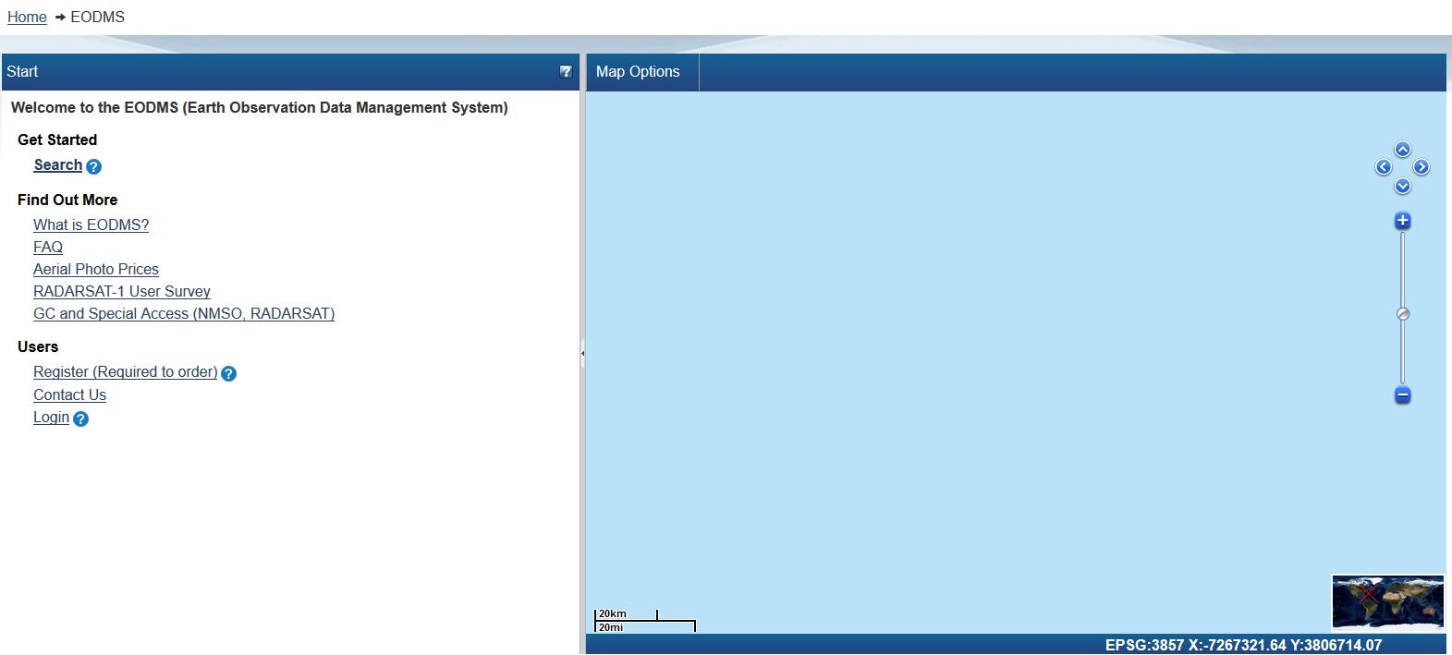
1. The CHALLENGE
Space Apps Ottawa 2019

Slide 3
THE CHALLENGE
Space Apps Ottawa 2019
Help the CSA and NRCan open more RADARSAT-1 data to the public.
Notes:
Focus on Friday night’s goal

Slide 4
THE ISSUE
Space Apps Ottawa 2019
April 1st, 2019: CSA opened >36k RADARSAT-1 satellite images to public
Downloadable through NRCan’s Earth Observation Data Management System(EODMS)
Only processed images can be used for analysis. RADARSAT-1 acquired a significant amount of data; 36k images corresponds to a very small portion of the entire archive.
To avoid processing costs, help identify and prioritize meaningful data for processing and public release.
Notes:
Focus on Friday night’s goal

Slide 5
THE NEEDS
Space Apps Ottawa 2019
We tackled sub-challenge 1: Automate searches on EODMS to identify rich sets of data to process
We focused only on the 800k raw footprint (which is 50% of complete RADARSAT-1 archive)
Notes:
Focus on Friday night’s goal

Slide 6
2. The SOLUTION
Space Apps Ottawa 2019

Slide 7
THE CONCEPT
Space Apps Ottawa 2019
“REALTOR.CA, FOR RADARSAT!”
Notes:
Focus on Friday night’s goal

Slide 8
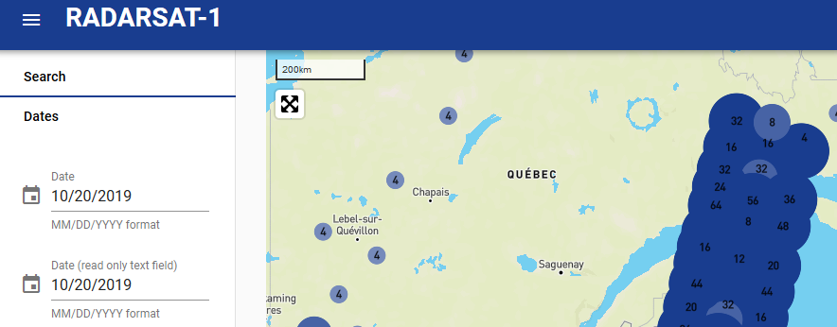
THE USER EXPERIENCE
Space Apps Ottawa 2019
“UX-first” solution design approach
We wanted something fast and intuitive
Focus on user exploration – therefore show all records by default
Records are extents and points
“Steps” and colours indicate quantify of records
Notes:
Focus on Friday night’s goal

Slide 9
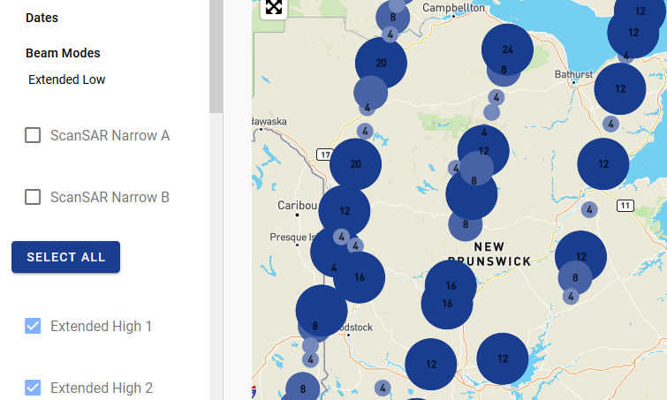
FILTERS & METADATA
Space Apps Ottawa 2019
Use filters to reduce the displayed records
Zooming and panning also removes records from display
Clicking on points shows property card pop-up
Queries are made to our local middle-ware geo metadata database rather than EODMS = fast
Notes:
Focus on Friday night’s goal

Slide 10
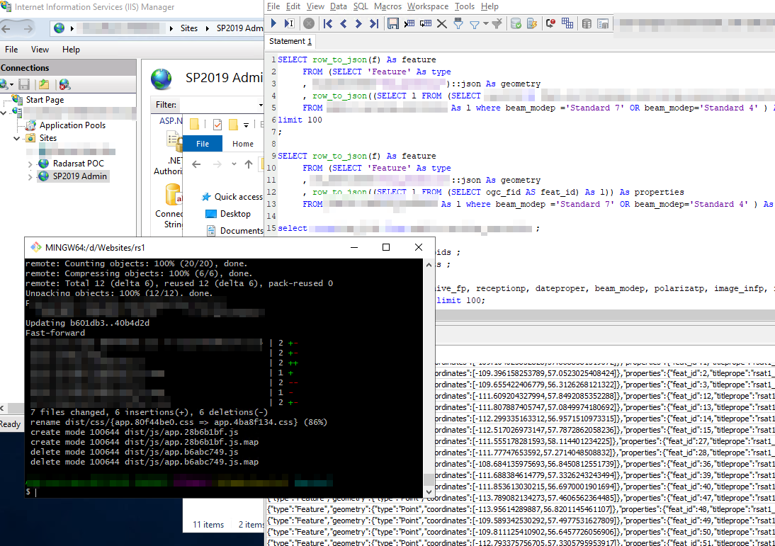
3. The SOLUTION ARCHITECTURE
Space Apps Ottawa 2019

Slide 11
SYSTEM COMPONENTS
Space Apps Ottawa 2019
Front End UX
MapBox, Vue.js, Beautify for UI, served by node.js backend. Talks to:
GEOJSON REST API
Custom REST api using C# Web.API. Talks to:
GEOSPATIAL METADATA DATABASE
PostgreSQL with PostGIS. Contains GeoJSON metadata. Loaded from:
GEOJSON EXTRACTS FROM EODMS
Hand-extracted from HMI, converted to GEOJSON using QGIS. Loaded into GEO METADATA DB by:
GEO META DB ETL UTILITY
Custom Powershell creating command line scripts to automate GEOJSON file extracts using Ogr2Ogr utility.
Notes:
Focus on Friday night’s goal

Slide 12
SYSTEM INFRASTRUCTURE
Space Apps Ottawa 2019
Web/Application Server
Amazon EC2 small instance, 1 CPU, 2GB RAM
Database Service
Local PostgreSQL db service on web server. Vnext would use hosted DB.
Local file store
Metadata and geojson extracts don’t take up much space (images are not downloaded). Think MB not GB.
Notes:
Focus on Friday night’s goal

Slide 13
DATA EXTRACTION PROCESS
Space Apps Ottawa 2019
Manual visits to EODMS HMI to extract 5k at a time
Export to CSV, Export to SHP
QGIS convert SHP to GEOJSON to centroids
Ran calculate centroid in QGIS to spit out extents
Then import centroids and extents to PostGIS db via ogr2ogr
REST API in front of PostGIS serves up the files to MapBox UX
Notes:
Focus on Friday night’s goal

Slide 14
THINGS THAT DIDN’T WORK
Space Apps Ottawa 2019
We couldn’t do direct connection due to CORS (security) – manual downloads and conversions of files = painful!!!
Using Elastic Search database as the data store – we didn’t have time to configure it for Geojson format so went with PostgreSQL db instead
We tried a Katalon script to automate extract the data but it didn’t work right away (needs more support/documentation)
Notes:
Focus on Friday night’s goal

Slide 15
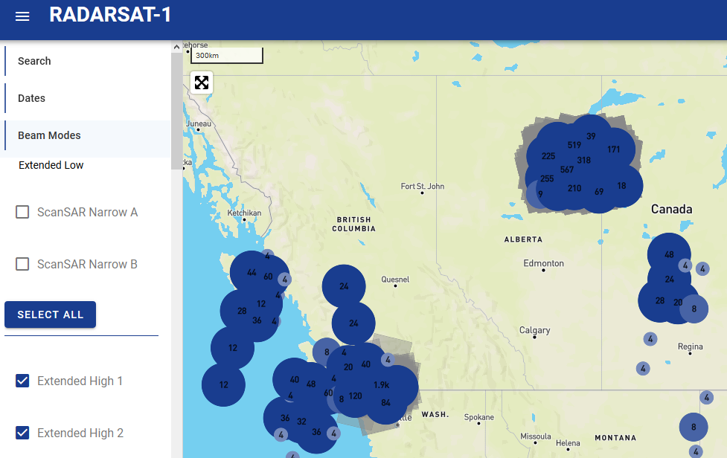
4. NEXT STEPS
Space Apps Ottawa 2019

Slide 16
VNEXT
Space Apps Ottawa 2019
Automate downloading and converting of EODMS images
Schedule Geo Meta DB intake process to find newly extracted files
Add more filters (beam mode only working filter currently)
We recommend a “whole” CSV file of 800k records that the public can use
Export button for data
Link to available image file for download form EODMS
Filter on raw vs processed data
Satellite/Street view toggle
Image count on screen
Notes:
Could probably lose this slide

